Slide 1
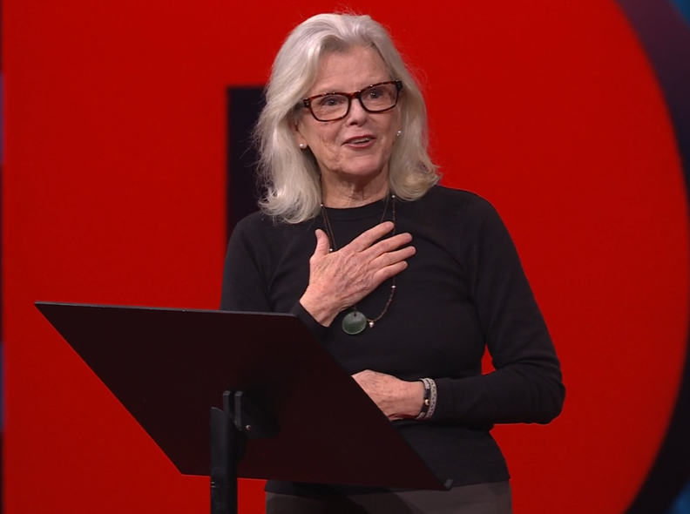
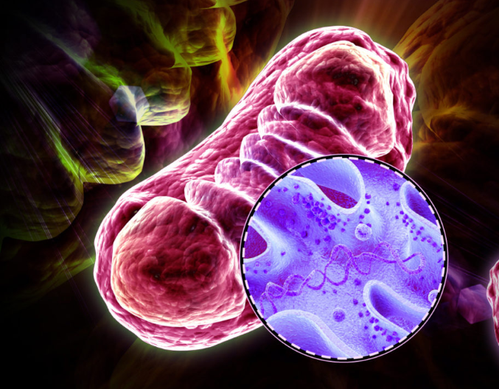
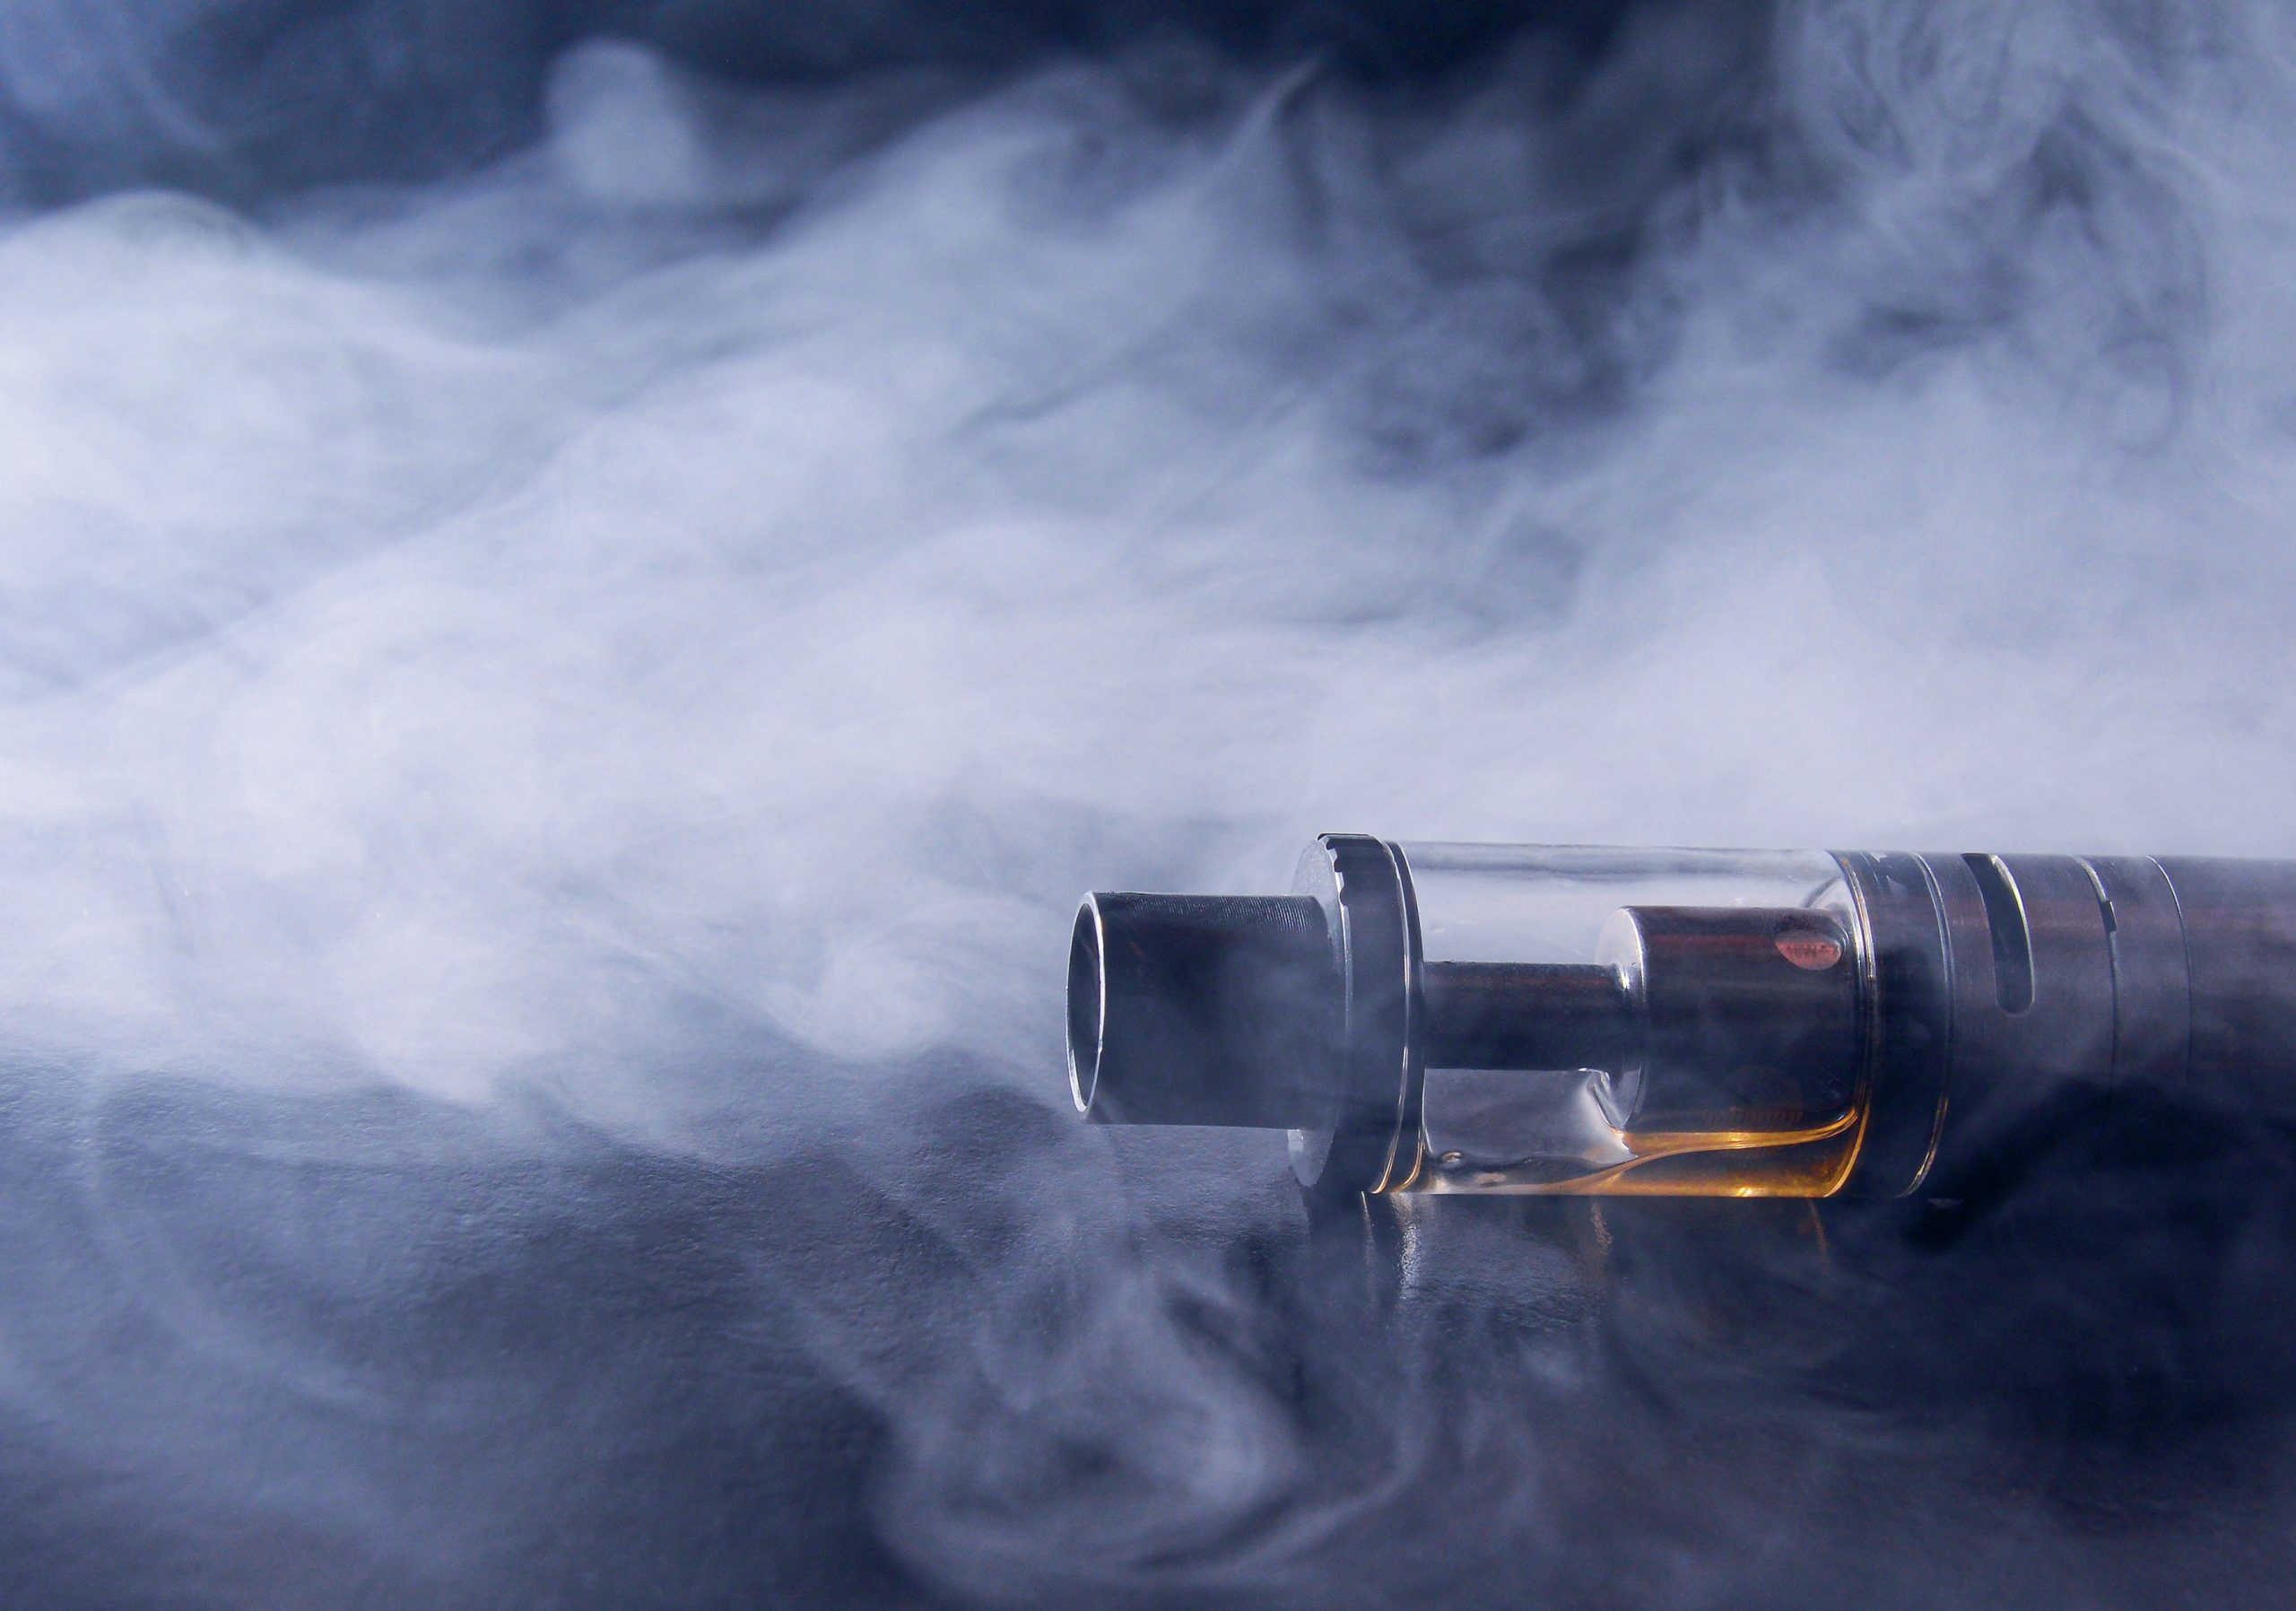
Biology A Level Summer Independent Learning
To get the top grades in A Level Biology, it is important that you have a wider understanding of how biology relates to the world around us beyond the specification. Here are three articles for you to engage with to give you a taster of some of the areas of biology that are topical at the moment.
Watch the TED TALK:
A Bold Plan to Rewild the Earth – at a massive scale
https://www.ted.com/talks/kristine_mcdivitt_tompkins_a_bold_plan_to_rewild_the_earth_at_massive_scale
The first step to saving nature is the rewilding of our own minds, says conservationist and former Patagonia CEO Kristine McDivitt Tompkins. With an unwavering commitment to protecting ecosystems, she and her late husband Douglas Tompkins created vast conservation parks across South America that allowed ancient flora and fauna to flourish once again. Now, she's carrying that legacy and mission forward with a bold plan to connect parks across geographic boundaries, creating a system of continental-scale wildlife corridors — before it's too late.
2. Read this article from Catalyst Magazine and write a short summary of the main points.
Mitochondria: You’ve got a friend in me
https://catalyst-magazine.org/articles/mitochondria/
Mitochondria are organelles that are extremely important to humans. Many people are unaware that the role of mitochondria is much more than just energy transfer and often overlook the fact that we could not survive without them. This article highlights the importance of mitochondria and mitochondrial dysfunction – what happens when mitochondria go wrong.
3. Read this article from Biological Sciences Review and write a short summary of the main points.
How e-cigarettes can ruin your smile
https://magazines.hachettelearning.com/magazine/biological-sciences-review/37/3/how-e-cigarettes-can-ruin-your-smile/
The health effects of e-cigarettes on the body, especially their impact on oral health, are not yet fully understood. Medical writer Maja Klys discusses what we currently know.

